Slide 1
Digital Music Composition using Genetic Algorithms
Stephen Bussey
Mentor: Dr. Alice Armstrong
Gihub.com/sb8244/GeneticMusicComposition

Slide 2
The Problem
Musicians can become lacking in inspiration.
The current GA techniques are heavily dependent on an operator and are inherently subjective.
The current GA techniques generate rhythms and tones at the same time, which may not be optimal.

Slide 3
Literature Review Highlights

Slide 4
Current Music Composition Techniques & Problems
Expert Systems
Markov Chain Models
Genetic Algorithms

Slide 5
What is a Genetic Algorithm?
Searching technique where a population of solutions is evolved over time
Key components include:
Representation of a solution as a chromosome
Selecting which chromosomes to cross over
How to cross over 2 chromosomes
How a chromosome can mutate
How a chromosome should be scored
When the end the algorithm?

Slide 6
Music Metrics
A variety of metrics were evaluated to determine effectiveness in classifying music
Consist of both rhythmic and tonal metrics
Many were found to be effective

Slide 7
Primary Objective
To compose music using Genetic and Memetic Algorithms by concurrently and separately processing the rhythmic and tonal components subject to the following criteria:
The level of effort shall not exceed 1 person-month over 12 weeks
The rhythmic component will be limited to the following set: whole note, half note, quarter note, eighth note, sixteenth note, whole rest, half rest, quarter rest, eighth rest, sixteenth rest
All music is assumed to be composed in 4/4 time (4 beats to a measure)
All music is composed without the use of tied notes
The tonal component will be limited to the pitches available via the MIDI specification
The composed music will be presented in MIDI format
The input music will consist of no less than 30 “walking bass lines” ranging between 8 and 12 measures each
The input music will contain no tied notes

Slide 8
Solution Description

Slide 9
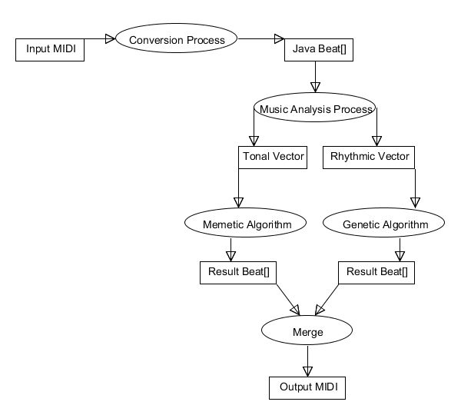

Slide 10

Music Analysis Vector
Vector that contains individual values of music components
The distance between two vectors is calculated using Euclidian Distance
http://en.wikipedia.org/wiki/Euclidean_distance#equation_1

Slide 11
Rhythm Chromosome
Consists of a fixed number of measures
Measure consists of beats
A beat contains duration and can be used to merge with notes later
Duration is in set (. 25, .5, .75, 1.0, 2.0, 3.0, 4.0)
Any beat can be a rest
Only the following durations can split (.5, 1.0, 2.0, 3.0, 4.0)

Slide 12
Tonal Chromosome
Tone is an integer from 0-127 (C0 – G10)
Pitch can be found from pitch % 12
The number of tones in each measure is the average number of tones per measure from the input

Slide 13
Genetic Selection
6-Point Tournament selection is used
6 random chromosomes are added to a set, and sorted by fitness
The top 2 fitness chromosomes are crossed over

Slide 14
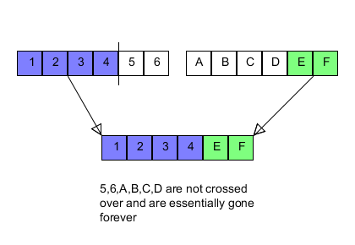
Genetic Crossover

Slide 15
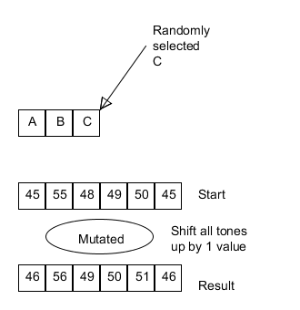
Mutations
Mutation percentages were determined in an operating point pilot
Involved seeing how the percentages affected
Each chromosome has a 10% chance of undergoing a mutation

Slide 16
Rhythm Mutations
Split a random beat in half (25%)
Combine 2 random neighboring beats (25%)
Swap 2 random beats (20%)
Reverse a random measure (1%)
Reset a random measure (1%)
Randomize a random measure (9%)
Reverse all measures (9%)
Swap 2 random measures (10%)

Slide 17
Tonal Mutations
Transpose random tone up or down (25%)
Transpose random measure up (10%)
Transpose random measure down (10%)
Swap 2 random notes (15%)
Randomize random measure (1%)
Reset random measure (1%)
Reverse random measure (9%)
Reverse all measures (14%)
Swap 2 random measures (15%)

Slide 18
Tonal Memetic Mutation
The first beat which is outside of the octave range is placed in the proper range
This occurs with 100% chance
It serves to prevent large variations in octaves which would take a long time to improve on

Slide 19

Fitness
Fitness is determined by comparing the Euclidean distance between an input ‘goal vector’ and a Chromosome’s vector
The error allowed is $\frac{1}{10}√vectorLength$
This allows for a scaling and dynamic fitness function which can be reused despite different fitness vector values between the two genetic algorithm variants

Slide 20
Fitness
When a chromosome reaches the desired error value, it is stored as the minimum
The GA does not terminate immediately
Continues for 15 more iterations to try to improve the minimum
After 15 iterations, the minimum is the return value
This allows for a good result to become even better

Slide 21
Termination Constraints
Randomization of the population occurs when
50 iterations occur consecutively without .01 fitness improvement
200 Iterations occur consecutively without .5 fitness improvement
This is an attempt to prevent local extrema in the search space
It is possible for a GA to not complete if it passes 2000 iterations

Slide 22
Population Sizes
Each population was chosen to be of size 1000

Slide 23
Goals and Hypotheses

Slide 24
Hypotheses
Null Hypothesis 1: The Music Analysis Process does not generate different Music Analysis Vectors for different pieces of music.
Research Hypothesis 2: The Music Analysis Process does generate different Music Analysis Vectors for different pieces of music.

Slide 25
Hypotheses
Null Hypothesis 2: The Genetic Algorithm does not produce a result satisfying the input Music Analysis Vectors within 10 minutes at least 75% of the time.
Research Hypothesis 2: The Genetic Algorithm does produce a result satisfying the input Music Analysis Vectors within 10 minutes at least 75% of the time.

Slide 26
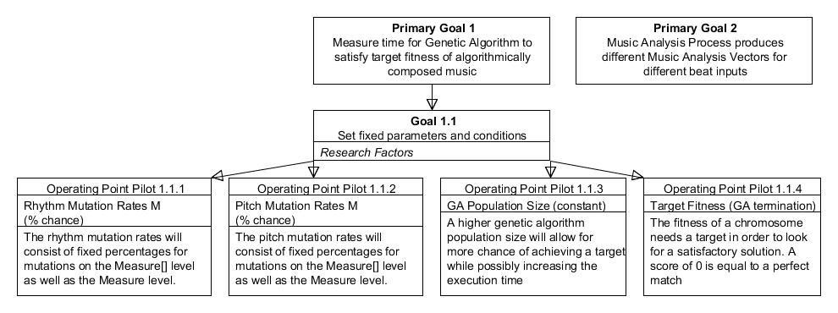
Goal Tree

Slide 27
Experiment Design

Slide 28
Experiment Design
For each input music
Genetic algorithms for rhythm and tone ran in parallel (collect time for each to completion)
The results of the genetic algorithms was combined into an output MIDI file
The output MIDI file and time to completion was recorded
This was run 30 times for each input to provide a normal distribution of the average execution time

Slide 29
Experiments Performed
Main
Performed using the original solution design
The entire rhythmic and tonal aspects are fed into two parallel genetic algorithms
Secondary
Performed using a divide & conquer solution
The rhythmic and tonal aspects are split into several smaller chunks, which are ran in parallel and merged at the end

Slide 30
Results & Conclusions

Slide 31
Experimental Results - Main
Of the 900 runs, 6 failed (.67%)
The average time with failures included is
27.04s +- 43.7s
The average time with failures removed is
24.7s +- 32.7s

Slide 32
Experimental Results - Secondary
Of the 900 runs, 138 failed (15.3%)
The average time with failures included is
68.1s +- 132.6s
The average time with failures removed is
16.4s +- 22.7s

Slide 33
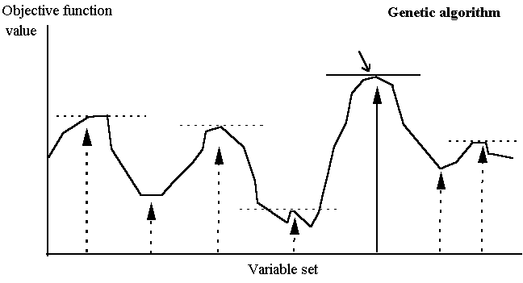
More Failures?
Chance of starting in the proper location is relatively low
Once started properly, chance of convergence is high
When this is repeated 6+ times instead of once, those probabilities multiply and become multiplicatively more difficult
http://www.economicsnetwork.ac.uk/cheer/ch13_1/images/mardl102.gif

Slide 34
Results
All experiments completed at least 75% of the time
All experiments completed within 10 minutes

Slide 35
Conclusions
Null Hypothesis 1 rejected, suggests acceptance of alternative hypothesis 1
Null Hypothesis 2 rejected, suggests acceptance of alternative hypothesis 2
Main experiment performed more reliably in terms of failure rate
This is due to the probability of convergence decreasing dramatically when more instances of the algorithm must be ran
The failure rate only affected certain inputs

Slide 36
Discussion
In a practical usage implementation, divergent inputs are not as common as convergent inputs
This means that the convergent times are what can be analyzed for practical performance costs
Advantage goes to the divide & conquer algorithm

Slide 37
Discussion
Walking bass lines and simple melodies performed best
Melodies with complex rest patterns did not perform well
Melodies with long similar tonal chains (even eighths of same note) did not perform well

Slide 38
How Did it Sound?
This is not a requirement of the analysis, BUT…
In general, the music sounded pretty good but was not easily identifiable according to the input
The input did serve well with regards to general shape of the output music, just not in terms of styles
Some output had really fast sections which do not sound natural

Slide 39
Directions for Future Work
The algorithms will only perform as well as the music analysis process
This process can be improved on dramatically by utilizing a more experienced music theorist to help determine critical components of melodies

Slide 40
Directions for Future Work
This implementation worked only with single melodies
It could be expanded to work with multiple tracked MIDI files
An expansion could be done to provide guidance to the reconstruction algorithm to determine how the song should be reconstructed
This would allow patterns and sequences to be defined by the user which would allow for actual songs to be created

